Slide 1
S.J.S.U Crime Stats
(2014-2019)
Project Task 4 Update
GR 4
Kevin Thai, Austin Tom, Antonio Perez, Shruti Hardasani, & Ching-Fen Juan
4/14/2023
Notes:
For our group, we would like to know if there is any significant levels of variances between some of the major types of crimes committed at SJSU.

Slide 2
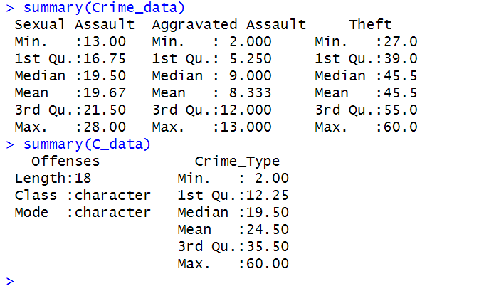
Descriptive Data
Notes:
On average, sexual assault had a mean incident of 19, aggravated assault had 8, and theft had about 45.

Slide 3
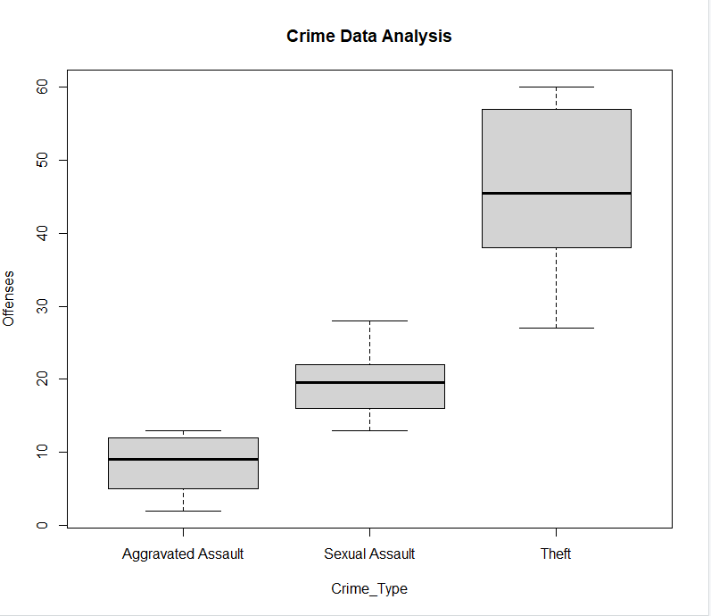
Data Visualization
Notes:
Theft happens to be the highest between and in between variance compared to AA and SA.That said, SA & AA have low inbetween variances.

Slide 4
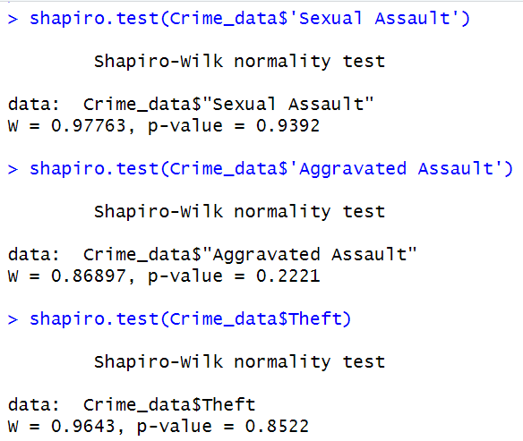
Shapiro Wilk Test

Slide 5
Analytical Approach: Anova Analysis (Observational Study)
PARAMETERS
U1 = SA (Sexual Assault)
U2 = AA (Aggravated Assault)
U3 = Theft
NULL & ALT HYPOTHESIS
H0 = U1 = U2 = U3
Ha = Not all equal
Notes:
In order to conduct our research, we used an ANOVA Analysis approach via Observational Study. For our null hypothesis, we would say that the means for each crime are equal and for our alternative hypothesis, they would not be equal.

Slide 6
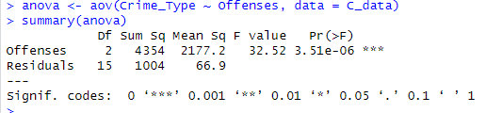
Preliminary Results
Assumptions
Level of Significance α = 0.05
Each observation is independent of each other
MSE: 66.94
Notes:
Since we rejected the null hypothesis, This means that we have sufficient evidence to suggest that not all population means are equal. we can use a pairwise comparison.

Slide 7
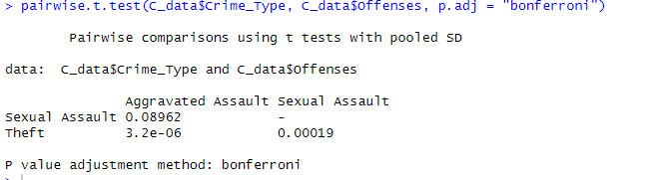
Pairwise Comparison (Bonferroni)
Notes:
Mean number of SA =/= to mean number of AA, Mean number of THEFT =/= to mean number of SA, Mean number of THEFT =/= to mean number of AA. We conclude that there is a significant variance of incident between the three majors crimes that have been committed at SJSU. In other words, it seems like the people affected by theft are not the same people being affected by SA or AA. That said, while SA and AA have a high between variance, they have a low inbetween variance.

